Slide 1
Distributed LQR Controller on a Clustered Power System Model
Nachiappan Chockalingam

Slide 2
Objective
To design a distributed LQR based controller to stabilize the oscillation modes of a six machine clustered power system model. Assuming all synchronous generators are decoupled.
Implement the controller on MATLAB/SIMULINK with two different communication graphs and compare the system response

Slide 3
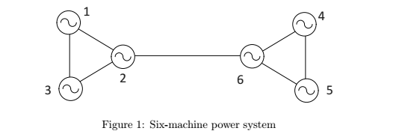
Power System Model
Model Parameters
E1 = E2 = E3 = E4 = E5 = E6 = 1
M1 = M2 = M3 = 1
M4 = M5 = M6 = 2
x12 = x23 = x31 = 0.01 pu
x45 = x56 = x64 = 0.05 pu
x26 = 0.05 pu
initial equilibrium
δ1,0 = 0.1, δ2,0 = 0.11, δ3,0 = 0.105, δ4,0 = 0.21, δ5,0 = 0.205, δ6,0 = 0.211

Slide 4

Assumption
Each machine is decoupled from the others
The machines are modeled by a SMIB PS model and the described by

Slide 5

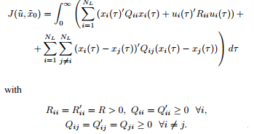
Control Design
Considering a set of N_{L} identical, decoupled linear time invariant dynamical systems governed by the continuous time state equation given below
We consider a LQR control problem to minimize the cost for set of of N_{L} systems where the cost function couples the dynamic behavior of the systems.

Slide 6

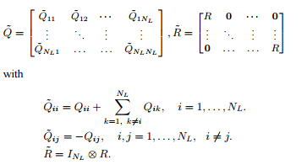
Compact Notation

Slide 7
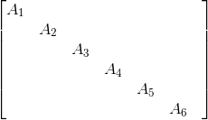
The system Matrix
A_{i} =
A =

Slide 8
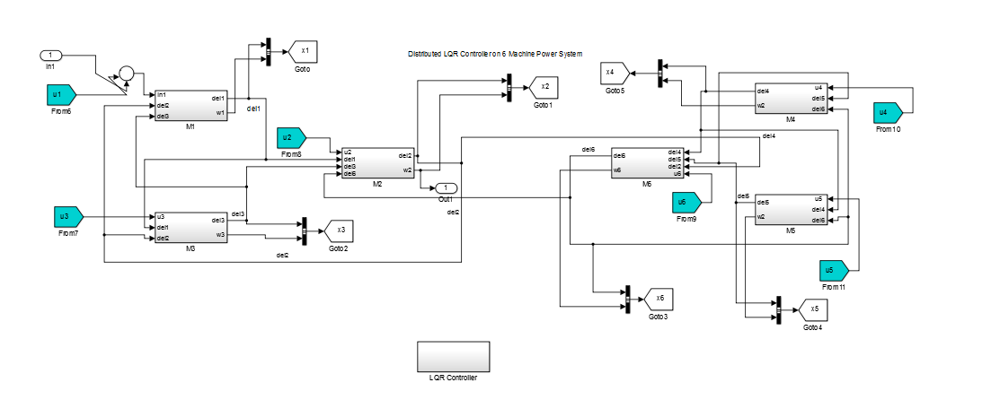
Simulation

Slide 9
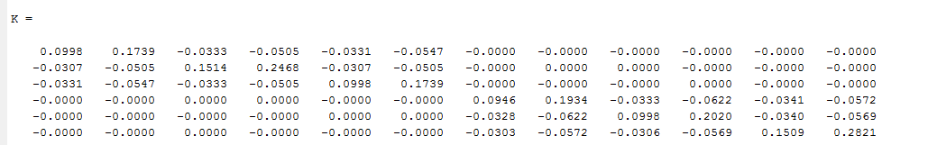

Slide 10
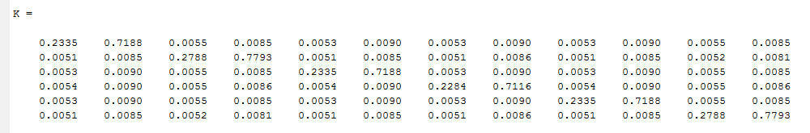

Slide 11
References
Borrelli, F., and T. Keviczky. "Distributed LQR Design for Identical Dynamically Decoupled Systems." IEEE Transactions on Automatic Control53.8 (2008): 1901-912.
“Cooperative Control “ Jeff S. Shamma – Wiley2007

